Slide 1
Transformers
Success Criteria
I can describe how transformers work and why they are useful.
I can determine whether a transformer is step-up or step-down.
I can calculate voltage, power, current and power loss through transmission.
Notes:
Eddy currents
Solenoid induced currents
Generators
Induced current due to Earth’s magnetic field

Slide 2
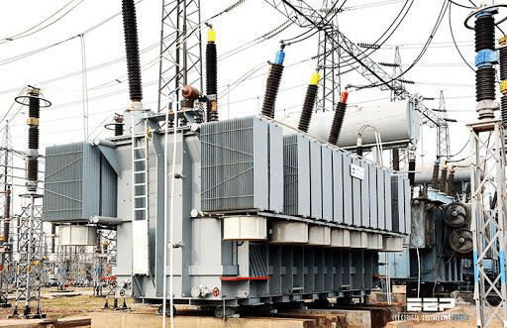
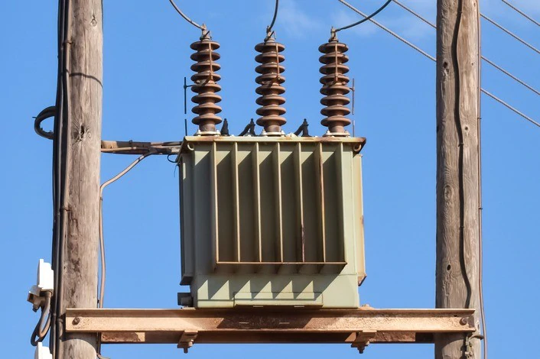
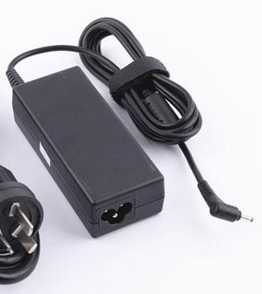
Transformers
Content Development
A transformer is a device used to increase or decrease the voltage supplied.
They are used extensively in power transmission and in everyday household devices.
Transformers are used to decrease the power lost when transmitting electricity over long
distances and to adjust power supplied in electrical devices to match specifications.
Notes:
Laptop charger transformer:
INPUT: 100-240 V ~ 2.5 A 50-60 Hz OUTPUT: 19.5 V = 6.7 A

Slide 3
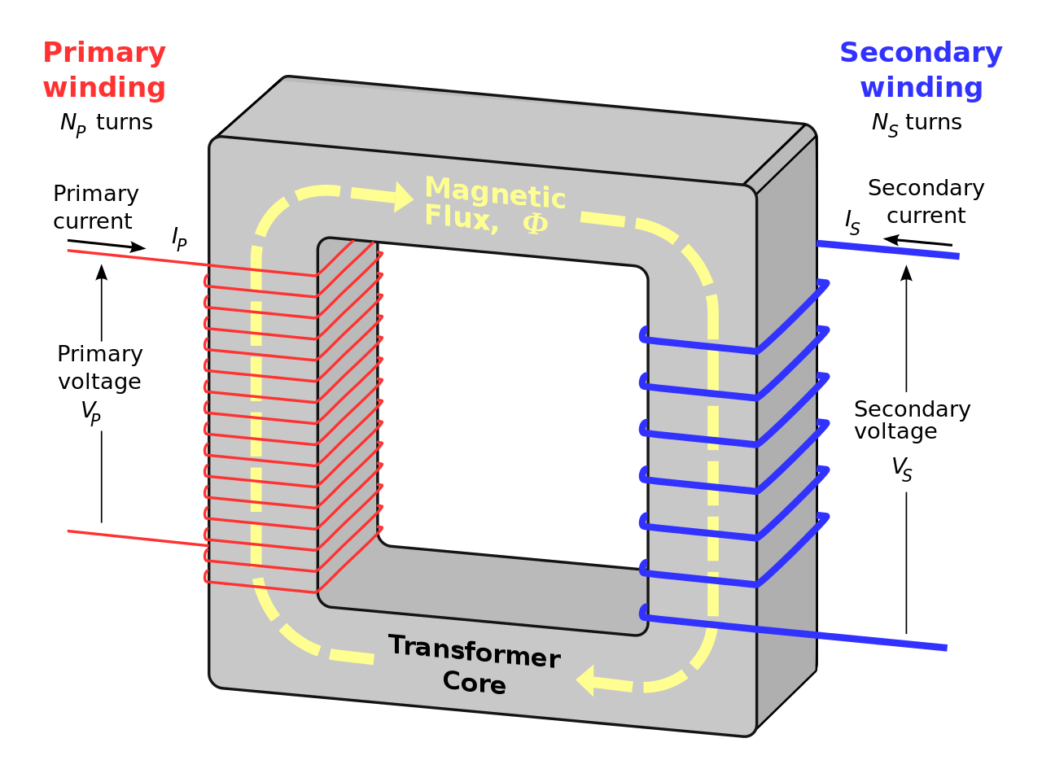
Transformers
Content Development
input
output
Notes:
Looks like two solenoids connected by a metal core
AC input across primary winding. Rapidly oscillating current → changing magnetic flux
Magnetic flux is carried by the ferromagnetic core.
The secondary winding is a solenoid which is subject to a changing magnetic field.
This induces a emf. The emf produced is a function of the number of turns (the amount of winding).

Slide 4
Transformers
Content Development
Primary Winding
The input circuit.
Has an AC source, producing a changing magnetic field.
Soft Iron Core
Directs and intensifies the changing magnetic field produced by the primary winding.
Secondary winding
The changing magnetic flux in the secondary winding induces an EMF (Faraday’s Law).
input
output

Slide 5
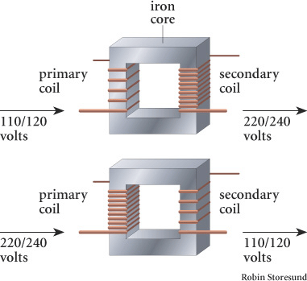
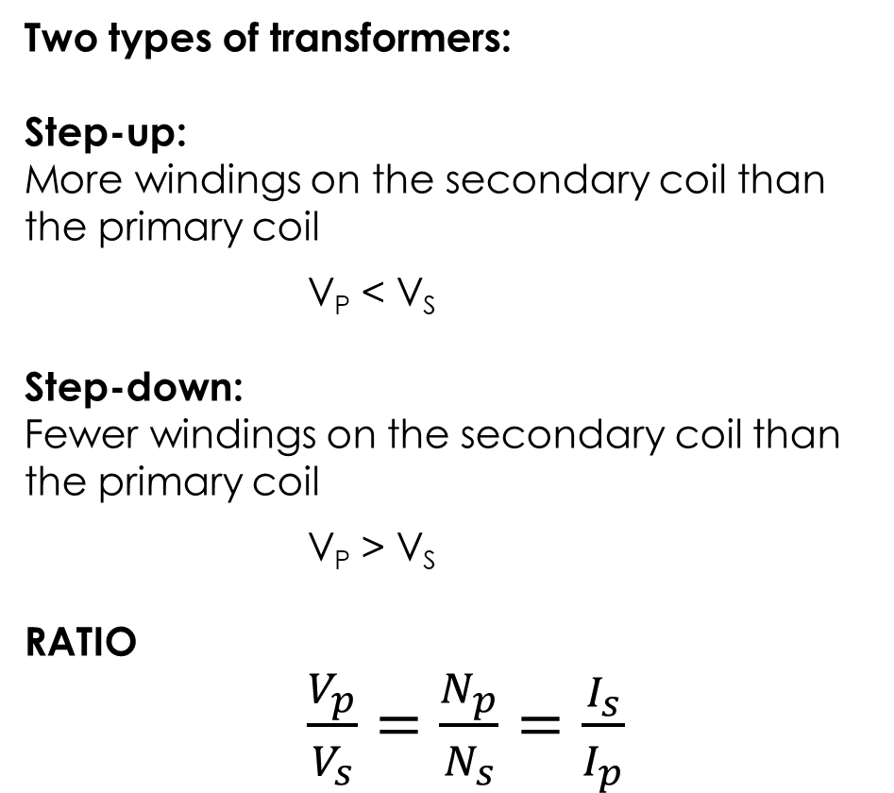
Transformers
Content Development
Two types of transformers:
Step-up:
More windings on the secondary coil than the primary coil
V_{P} < V_{S}
Step-down:
Fewer windings on the secondary coil than the primary coil
V_{P} > V_{S}
RATIO
$\frac{V_{p}}{V_{s}}=\frac{N_{p}}{N_{s}}=\frac{I_{s}}{I_{p}}$
input
output
Step-up
Step-down
Notes:
Can think of it like a step (if you group all the windings to the bottom of the coil).
For the first diagram, you would step up from the primary coil to the secondary coil.
The ratio of voltages equals the ratio of windings.

Slide 6
Transformers
Content Development
A transformer is built into a portable radio to reduce the 240V supply voltage to the required 12V for the radio.
If the number of turns in the secondary coil is
100,
Is this a step-up or step-down transformer?
What is the number of turns required in the primary coil?
input
output
Notes:
a) Voltage is going down. Step down transformer
b)
Vs = 12; Vp = 240; Ns = 100
Find Np
Np = 2000 turns

Slide 7
Transformers – Power Output
Content Development
Transformers are fantastically efficient – sometimes higher than 99% efficiency – but they aren’t perfect. There is always some inefficiency:
some of the magnetic fields do not pass through the iron core
there are eddy currents which resist the change in flux.
Transformers are designed so that the voltages are carefully controlled. It is the current that will be affected by efficiency.
V_{p}I_{p} * efficiency = V_{s}I_{s}
P_{in} * efficiency = P_{out}

Slide 8
Transformers – Power Output
Content Development
Example question:
A step-down transformer has 200 windings on one side and 50 windings on the other. The primary voltage is supplied at 240 V. The transformer powers a 200 W fan.
Calculate the secondary voltage.
Calculate the secondary current.
Calculate the primary current if the transformer is 89.0% efficient.
Notes:
Vp/Vs = Np/Ns 240/Vs = 200/50 Vs = 60.0V
Pout = VsIs 200 = 60*Is Is = 3.33 A
Pin * efficiency = Pout Pin * 0.89 = 200 Pin = 224.7W
Pin = VpIp 224.7 = Ip / 240 Ip = 9.36 x 10^-2 A

Slide 9
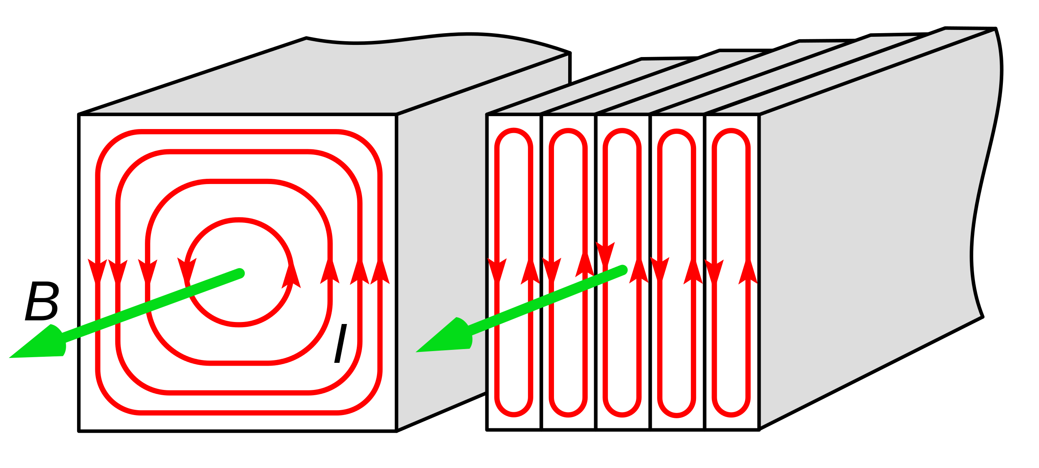
Transformers – Eddy Currents
Content Development
The changing flux produced by the primary winding induces an EMF in the secondary winding but it also induces an EMF in the soft iron core. This drives eddy currents (circular currents with the iron core).
Eddy currents cause energy losses in the transformer in the form of resistive heating in the core.
Preventative measure
Laminate the iron core – that is, separate the iron into stackable sections that are insulated from each other. This reduces the intensity of the eddy currents and the magnitude of the energy losses.

Slide 10
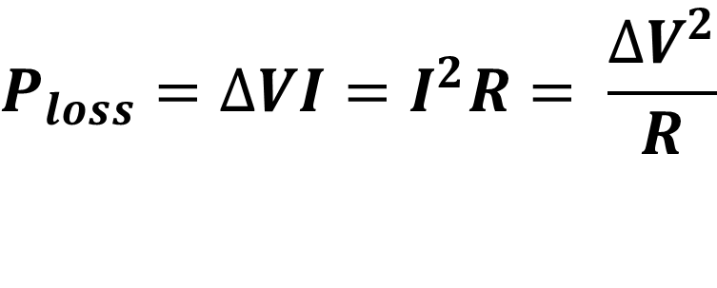
Transformers – Long-range Power Transmission
Content Development
While we’ve tended to assume that wire are perfect conductors previously, they are not – especially over the long distances required for the transmission of electricity from power plants to cities and homes.
$$P_{loss}=∆VI=I^{2}R= \frac{∆V^{2}}{R}$$
Be very careful with which equation you used for power loss. The deltaV is the voltage drop due to resistance in the line. You cannot use the voltage coming out of the transformer in this equation.
It is far safer to use the I²R equation.
The current is constant in a series circuit so use the current and you are unlikely to make a mistake.
Notes:
Calculate the power loss in a circuit with a power of 3 MW, a resistance of 0.01 ohms and a voltage of 240 V
Calculate the power loss in a circuit with a power of 3 MW, a resistance of 0.01 ohms and a voltage of 2400 V

Slide 11
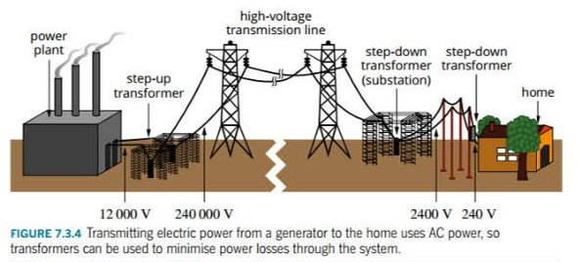
Transformers – Long-range Power Transmission
Content Development
Notes:
Standard power transmission system:
Power generated from a power plant at a high voltage (12 000 V)
Step-up transformer (240 000 V)
Transmission on high-voltage transmission line
Step-down transformer (2400 V)
City transmission power lines
Step-down transformer into home (240 V)

Slide 12
Transformers – Long-range Power Transmission
Content Development
A generator produced 220 kW at 950 V. This power is transmitted through a 4.00 ohm cable to a shopping centre.
Calculate the power loss of the cable
An ideal step up transformer with 1:56 winding ratio is installed near the generator before the power flows into the cable. Calculate the new power loss of the cable.
Notes:
a)
Pgen = VI 220000 = 950 * I I = 231.6 A
Ploss = IIR = 231.6*231.6*4 = 215 * 10^3 W
b)
Transformer:
Is/Ip = Np/Ns Is / 231.6 = 1 / 56 Is = 4.136 A
Ploss = IIR = 4.136 * 4.136 * 4 = 68.4 W

Slide 13
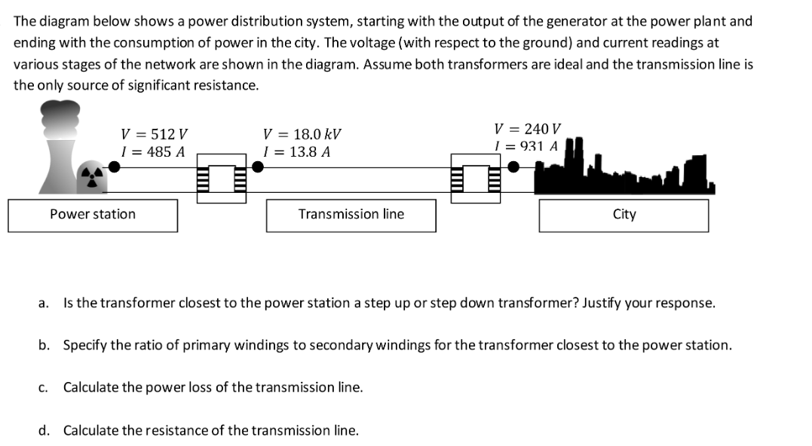
Transformers – Long-range Power Transmission
Content Development

Slide 14
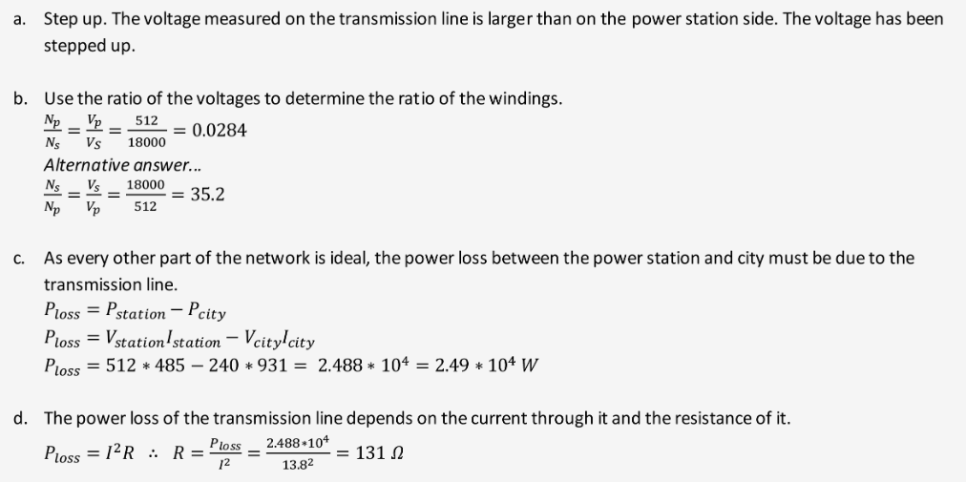
Transformers – Long-range Power Transmission
Content Development

Slide 15
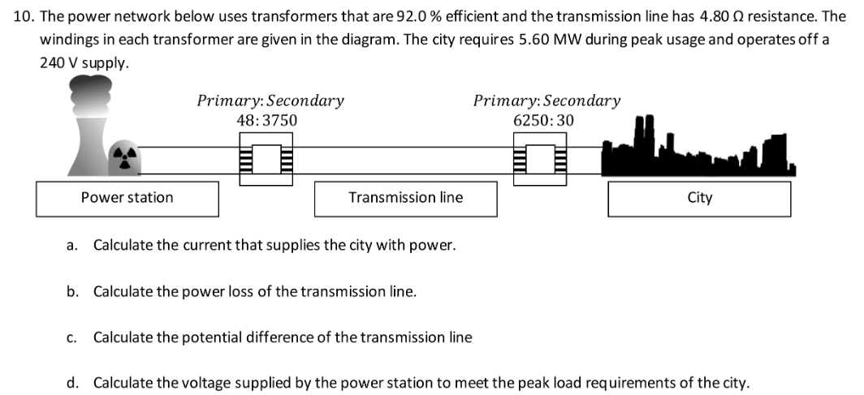
Transformers – Long-range Power Transmission
Content Development

Slide 16
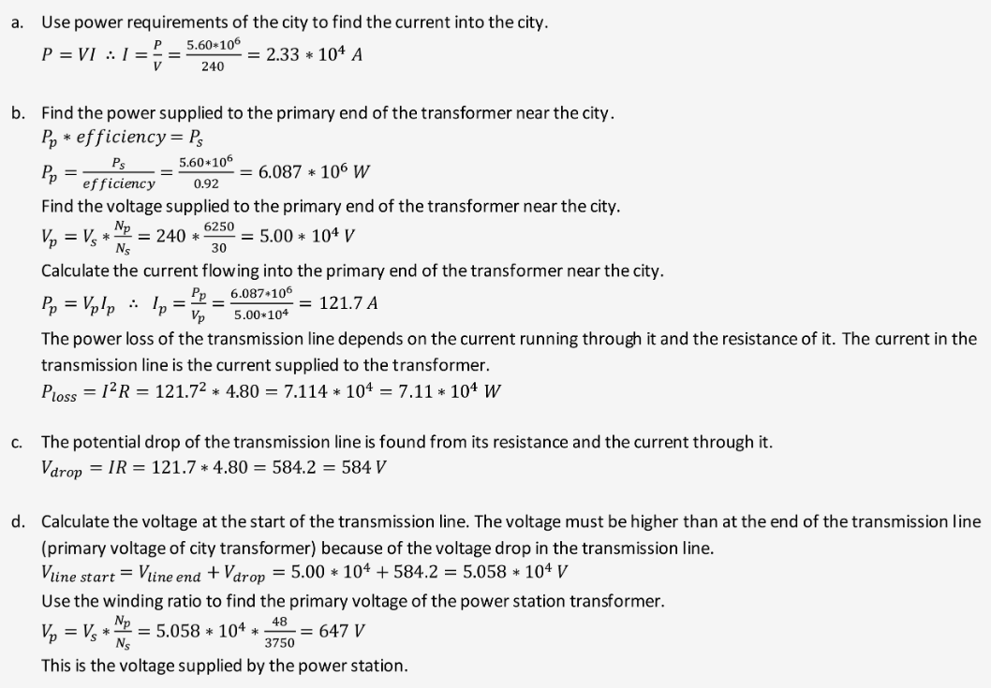
Transformers – Long-range Power Transmission
Content Development

